Slide 1
Improved Alzheimer’s disease (AD) Diagnosis with U-Net Variants Trained on Brain MRI Scans
CS 512 Computer Vision - Spring 2023 - Group 11
Jiaxin Dong A20499780
Toluwani Oyewusi A20425821

Slide 2
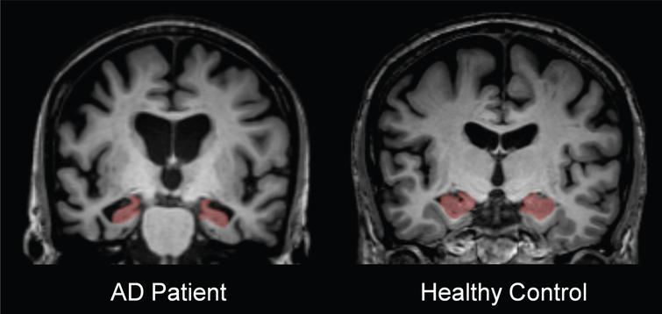
Introduction
Alzheimer's disease(AD) is the main cause of dementia.
Individuals with the AD usually experience difficulties in learning, performance speed, recall accuracy and/or problem solving.
The hippocampus helps us develop new memories also retrieving old memories.
The hippocampus is one of the first areas in the brain affected by Alzheimer's disease is the hippocampus.
Notes:
Alzheimer's disease is the main cause of dementia and one of the great health-care challenges of the 21st century. concern with huge implications for individuals and society. Individuals with the disorder usually experience difficulties in learning, performance speed, recall accuracy and/or problem solving.[1]
The hippocampus helps us develop new memories.[2] Some research shown that the hippocampus is important for not just forming new memories but also retrieving old memories.[3] And other research has found that one of the first areas in the brain affected by Alzheimer's disease is the hippocampus.[4]﻿
Computer vision techniques offer the potential to increase the effectiveness and accuracy of medical image analysis. Thus, a system that can automatically determine whether medical images include AD is required in order to increase the diagnostic process’ speed and precision.

Slide 3
Problem statement
Develop a deep learning-based approach for the automatic identification and diagnosis of Alzheimer's disease trained on brain MRI scans.
Preprocess and prepare the dataset for training and evaluation, including standardization, normalization, and data augmentation techniques.
Implement and train U-Net and its variants, such as U-Net++, on the preprocessed dataset to develop models capable of segmenting regions of interest and classifying Alzheimer's disease.
Evaluate the performance of the trained models using appropriate metrics.

Slide 4
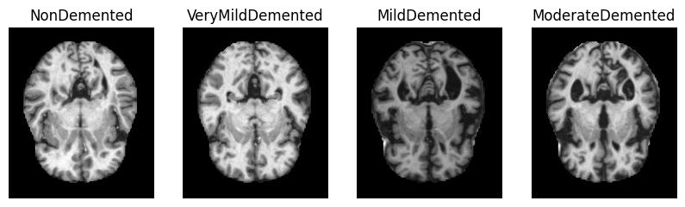
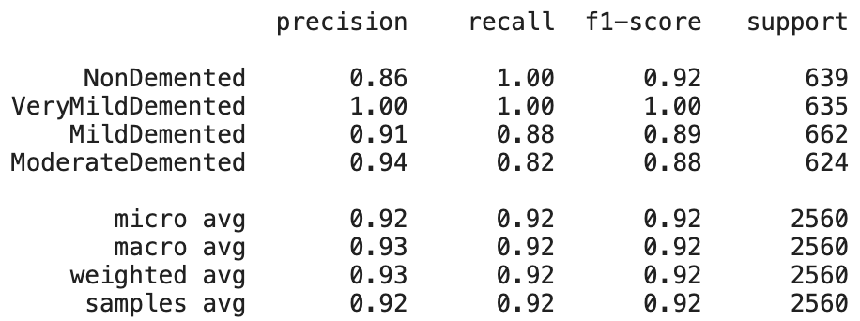
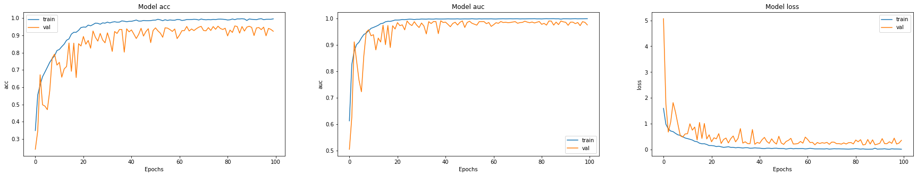
Relative work
Data source: Kaggle, Alzheimer's Dataset ( 4 class of Images)
Notes:
To use the Kaggle Alzheimer's Dataset, which contains four classes of images, we classify Alzheimer's disease.
We trained a deep learning model such as use InceptionV3 on the training set of MRI images, with the corresponding class labels (i.e. Mild Demented, Moderate Demented, Non Demented, and Very Mild Demented) as the ground truth.
The model can then be used to predict the class of MRI images in the testing set. The accuracy of the classification can be evaluated by comparing the predicted class labels with the true class labels of the testing set. The model can be fine-tuned using various hyperparameters, such as learning rate, number of layers, and batch size, to improve its accuracy.

Slide 5
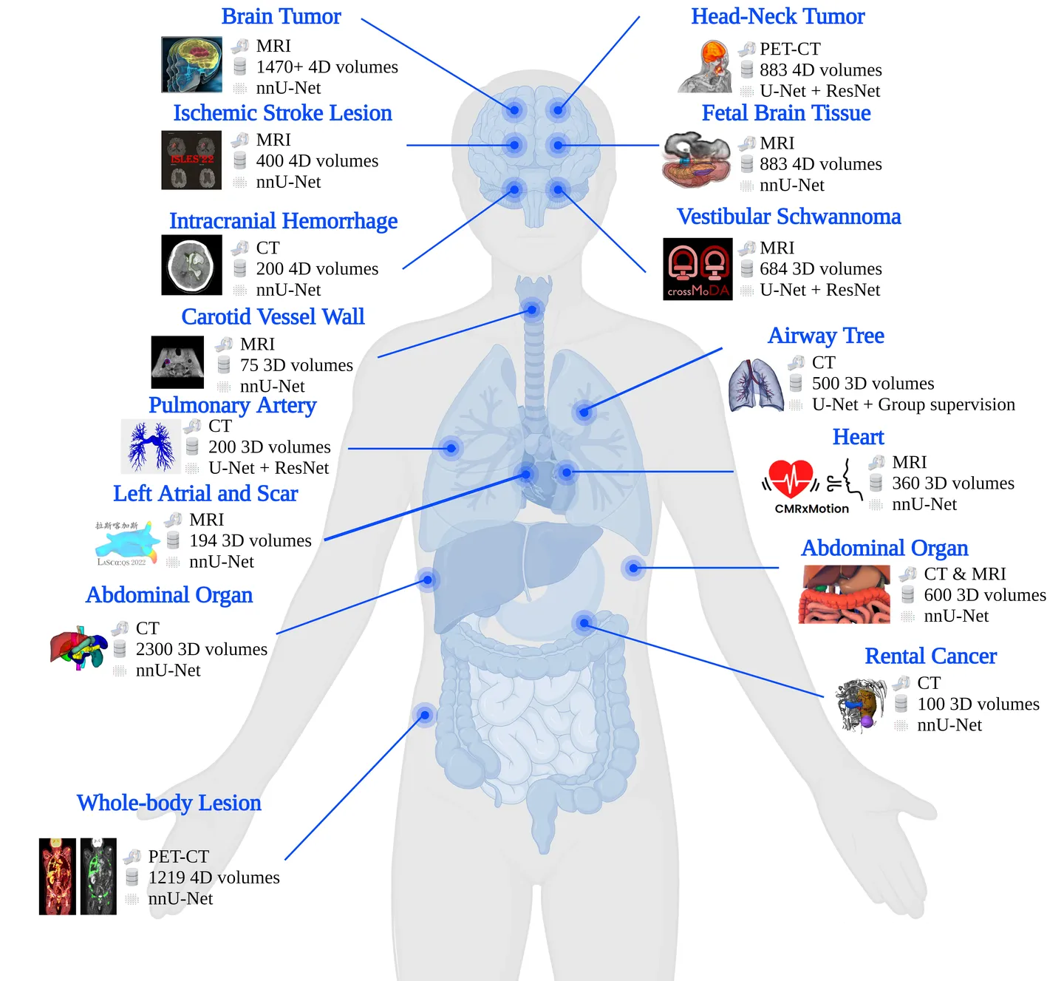
Relative work
MICCAI 2022
Notes:
According to “The Medical Image Computing and Computer Assisted Intervention Society” 2022, To train a model for medical image segmentation using MRI, the majority of the existing literature has utilized various versions of the U-Net architecture. The U-Net architecture has been shown to be particularly effective in segmenting medical images due to its ability to capture both high-level and low-level features. By utilizing various U-Net variants and optimizing hyperparameters, researchers can develop accurate and efficient models for segmenting medical images.

Slide 6
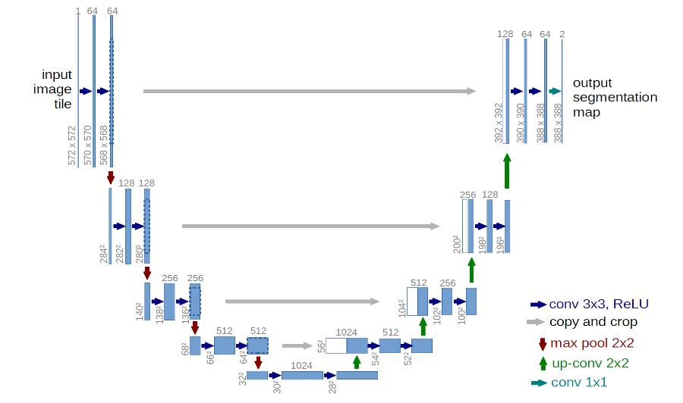
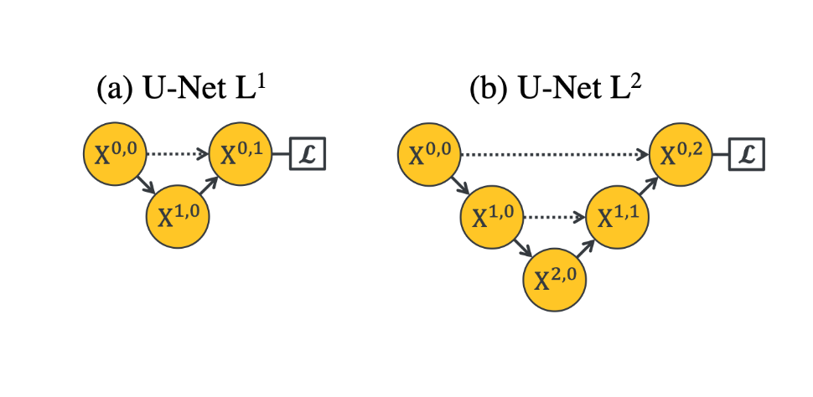
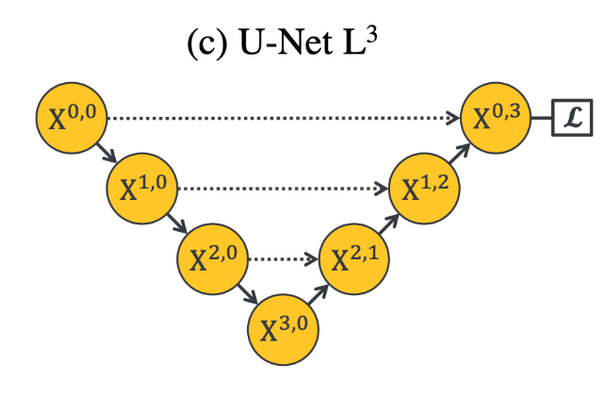
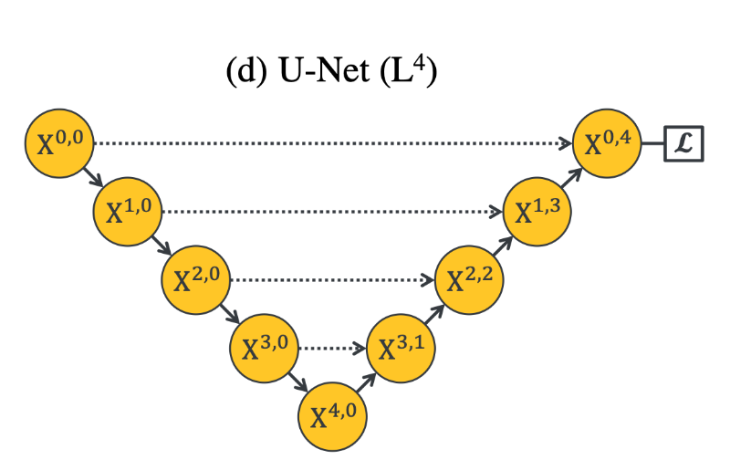
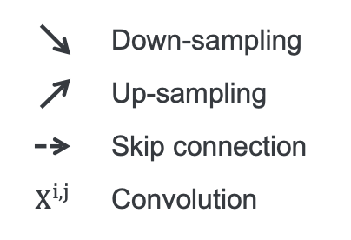
Proposed Solution
Why up-sampling until 4 level?
Notes:
Is downsampling necessary for segmentation networks? The reason for asking this question is that since the input and output are both images of the same size, why bother downsampling and upsampling them?
Because this can increase the robustness of the model to small perturbations in the input image, such as image translation and rotation, reduce the risk of overfitting, decrease computation complexity, and increase the receptive field size. The main function of upsampling is to decode the abstract features back to the original image size and ultimately obtain the segmentation result.
Shallow layers in a CNN typically learn to detect basic features in images, such as edges, colors, and textures. On the other hand, deep layers in the network, with larger receptive fields and more convolutional operations, can learn more complex and abstract features.

Slide 7
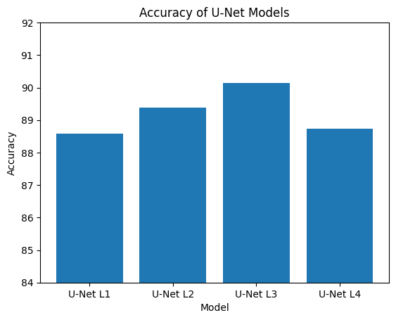
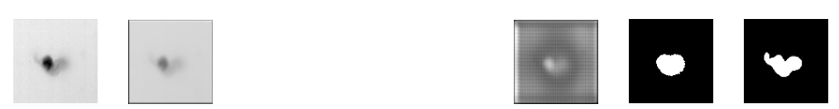
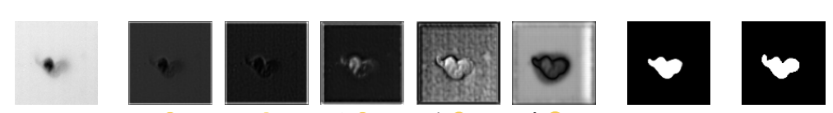
Proposed Solution
Cell Segmentation
Input X(0,0) X(0,1) X(0,2) X(0,3) X(0,4) Output Truth
U-Net
U-Net++
Data source: VisionGate
Notes:
Some tasks involving simple image information and others having more complex and rich information. A shallow network might be enough for simpler tasks, while more complex tasks may require deeper network structures. The original UNet architecture had limitations in accommodating this versatility. UNet++ improves upon this by introducing nested UNet subnetworks at different depths, which enhances the adaptability and effectiveness of the network for a wider range of tasks.

Slide 8
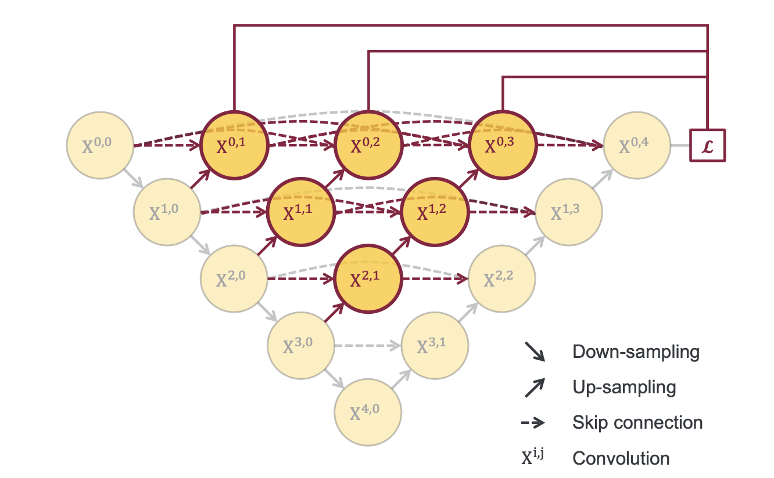
Proposed Solution
U-Net++
Redesigned skip pathways
Increase feature fusion
Dense feature map connections
Concatenation for re-usable intermediate representations
Notes:
U-Net++ employs a nested, densely connected, and deeply supervised structure to enhance the original U-Net's capabilities.
The proposed improvements focus on redesigning skip pathways to boost feature fusion and densely connect feature maps for better information flow. Concatenation, instead of summation, is used to allow subsequent layers to re-use intermediate representations more effectively.

Slide 9
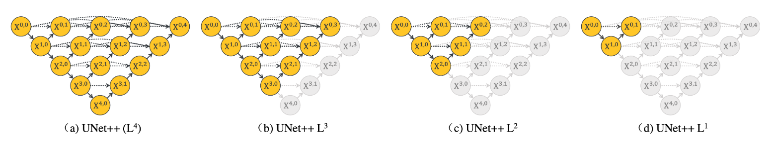
Proposed Solution
U-Net++
The use of deep supervision
Model pruning for speed-accuracy balance
Multi-depth output ensembling
Notes:
Training UNet++ with deep supervision makes segmentation results available at multiple nodes X0,j, enabling architecture pruning at inference time. Taking the segmentation result from X0,4 leads to no pruning, UNet++ (L4), whereas taking the segmentation result from X0,1 results in a maximally pruned architecture, UNet++ L1. Note that nodes removed during pruning are colored in gray.
The model incorporates deep supervision to enhance learning, and allows for pruning, which provides a speed-accuracy trade-off.
Finally, ensembling multi-depth outputs results in improved overall accuracy for the model. These enhancements aim to optimize the network's performance while maintaining its versatility for various segmentation tasks.

Slide 10
Prepare dataset
Folder Structure
original
100
ADNI_002_S_0295_13722_ACPC
ADNI_002_S_0295_13722_ACPC_001.jpg
…
ADNI_002_S_0295_13722_ACPC_189.jpg
…
ADNI_136_S_0579_116340_ACPC
35
…
label
100label
ADNI_002_S_0295_13722_ACPC
ADNI_002_S_0295_13722_L
ADNI_002_S_0295_13722_L_001.jpg
…
ADNI_002_S_0295_13722_L_189.jpg
ADNI_002_S_0295_13722_R
ADNI_002_S_0295_13722_R_001.jpg
...
ADNI_002_S_0295_13722_R_189.jpg
…
ADNI_136_S_0579_116340_ACPC
35label
…
The label folder is incomplete for a patient as it is missing the right hippocampus data for the brain.
Data source: Kaggle, MRI Hippocampus Segmentation
Notes:
This dataset contains MRI segmentation of Hippocampus.
There are two parts:
first part contains images of 100 people as train data and
the second part contains images of 35 people as test data.
All images are for people suffering from Alzheimer's.
I want to mention, the dataset contains 18,711 in total rather than the expected 18,900 (189*100) images since one patient’s label folder was lacking the hippocampus data for the right brain.

Slide 11
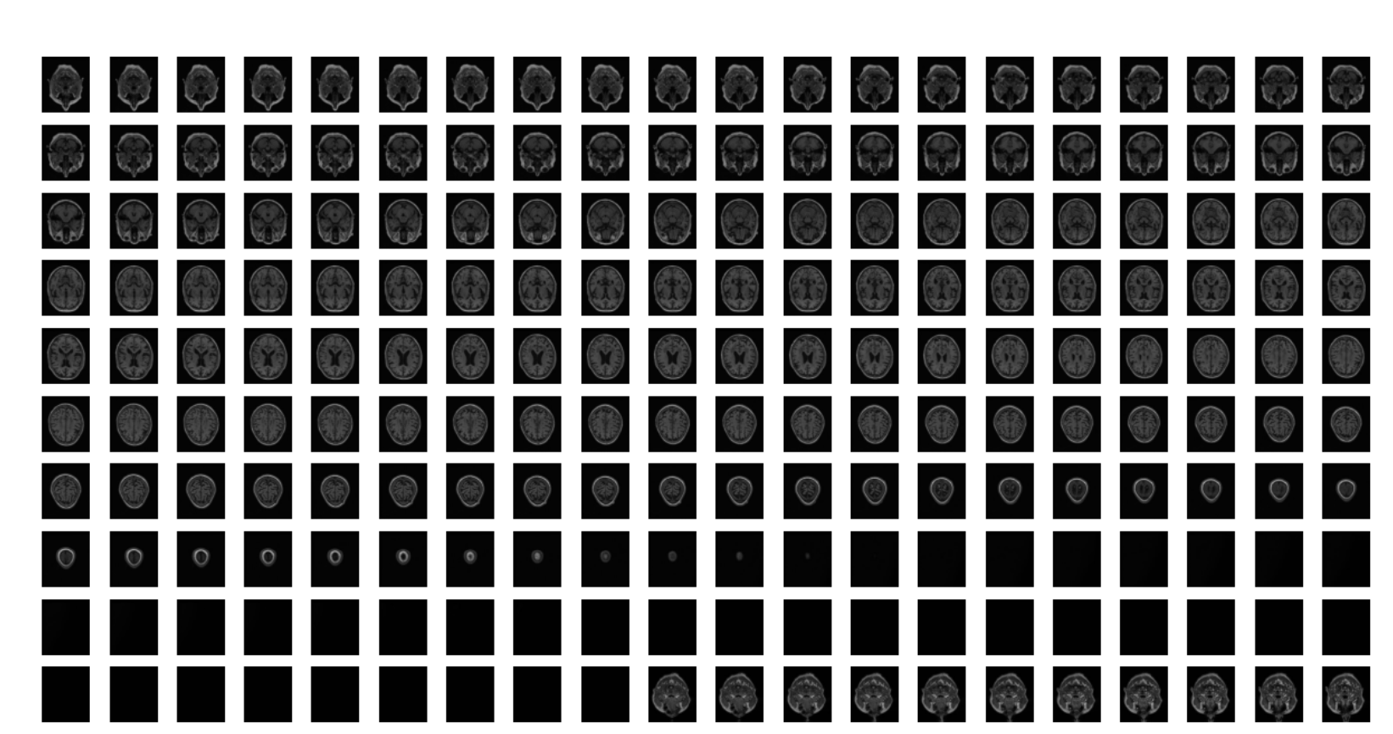
Prepare dataset
Original (first 200 images)
Notes:
This is an example of the brain MRI from original folder.

Slide 12
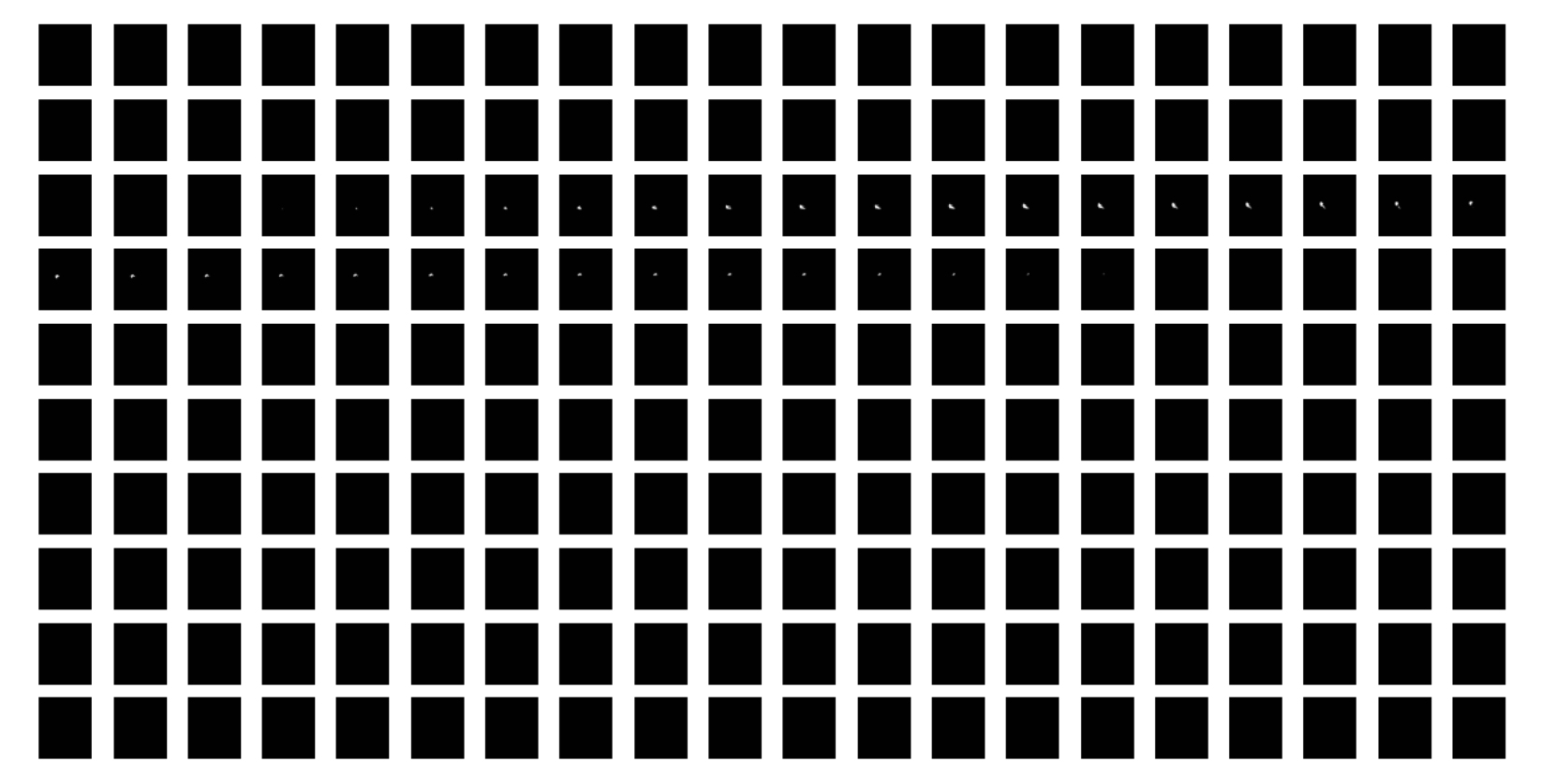
Prepare dataset
Label (first 200 images)
Notes:
This is an example of the MRI segmentation of Hippocampus from label folder.

Slide 13
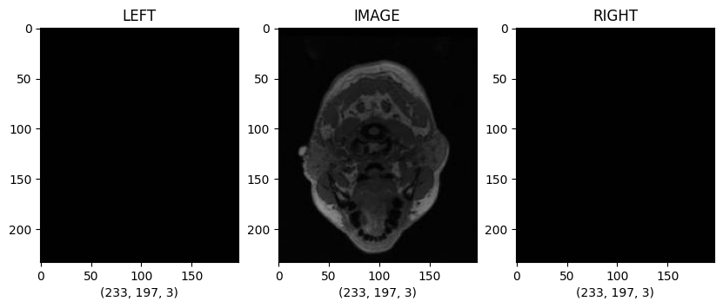
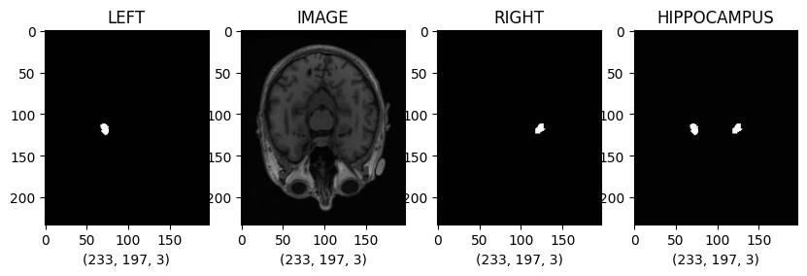
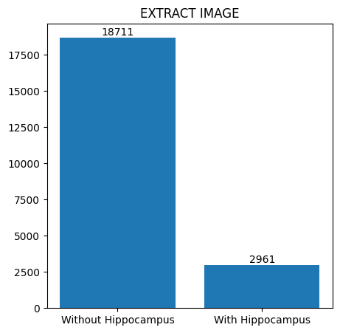
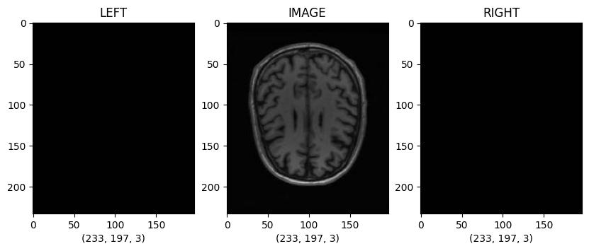
Prepare dataset
Notes:
There are 29 61 images include the hippocampus.
After extract image with hippocampus, we first zip left and right brain hippocampus into a single label image.
Then divide the dataset with an 80:20 split ratio, into training and validation sets.

Slide 14
Model Architectures
U-Net
Encoder-Decoder structure
Convolutional blocks with ReLU and batch normalization
Max-pooling for downsampling
Upsampling with skip connections
U-Net++
Encoder-Decoder structure
Convolutional blocks with ReLU and batch normalization
Max-pooling for downsampling
Upsampling with additional nested skip connections
Dropout rate for regularization
Deep supervision
Notes:
For our model architectures, we included a dropout_rate in U-Net++ architecture to improve the generalization of the model.
By adding dropout layers within the encoder-decoder structure and convolutional blocks (with ReLU(Rectified Linear Unit) and batch normalization),
we can effectively prevent overfitting while training the model.

Slide 15
Loss Functions
Binary Cross-Entropy Loss (BCE):
Calculates the difference between predicted probabilities and binary ground truth labels, commonly used in binary classification tasks.
Dice Loss:
Measures the overlap between predicted segmentation and ground truth, particularly useful for imbalanced class segmentation tasks.
Combine Loss:
Combination of Binary Cross-Entropy Loss (BCE) and Dice Loss.
Notes:
For the loss functions, we use BCE calculates the difference between predicted probabilities and binary ground truth.
Dice Loss, on the other hand, measures the overlap between them.
We also combine the BCE and Dice Loss together to make a Combined Loss function.
The weights determine the balance between the two losses and can be adjusted to prioritize one.

Slide 16
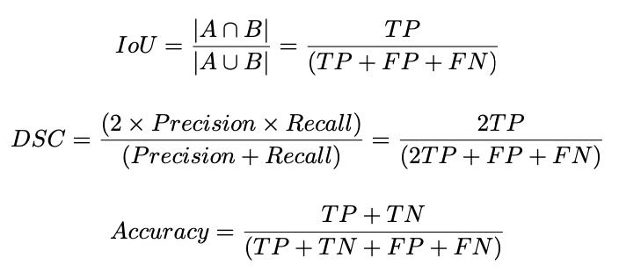
Evaluation Metrics
FP: false positive, FN: false negative, TP: true positive, and TN: true negative
Notes:
We implement the IoU (Intersection over Union) and DSC (Dice Similarity Coefficient) scores measure the overlap between the predicted segmentation and the ground truth.
We also bring the accuracy score evaluate the overall performance.

Slide 17
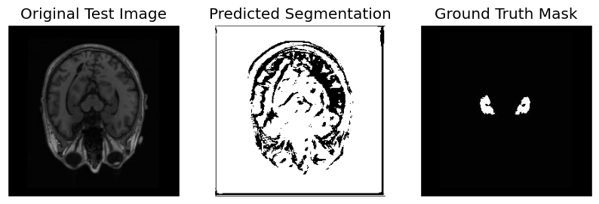
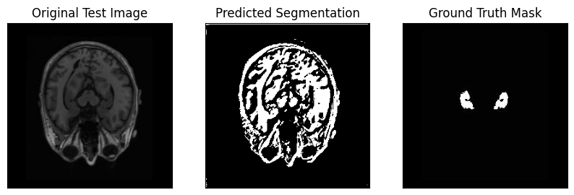
Hyper Parameters
Optimizer: Utilize the Adam and SGD optimizer for updating model weights. Known for its adaptive learning rate and efficient performance on deep learning tasks.
Learning Rate Scheduler: Implement the Cosine Annealing and CyclicLR learning rate scheduler. Cosine Annealing scheduler gradually decrease the learning rate, allowing the model to converge to a better solution.
Regularization Techniques: Apply dropout layers within the architecture to prevent overfitting, promoting robustness and generalization to new data.
Notes:
Adjust the hyper parameters of the model, such as optimizer, learning rate scheduler and regularization techniques.
We test the model with different combinations of hyper parameters and discovered that U-Net++ better than the original U-Net architecture.

Slide 18
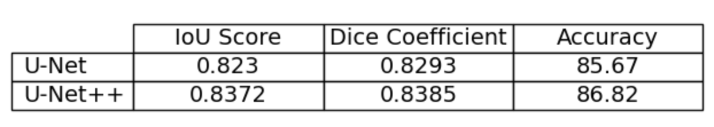
Results and Evaluate
With the addition of nested skip connections and deep supervision, U-Net++ model is able to learn more detailed feature representations and generalize better on previously unseen data.
U-Net++ model typically takes more time to train compared to the original U-Net for the same dataset and number of epochs.
This trade-off often leads in enhanced performance, as U-Net++ tends to produce better segmentation results compared to the original U-Net.
Notes:
With the addition of nested skip connections and deep supervision, U-Net++ model can learn more detailed feature representations and generalize better on unseen data.
However, U-Net++ model typically takes more time to train
This trade-off often leads in enhanced performance, as U-Net++ tends to produce better results.

Slide 19
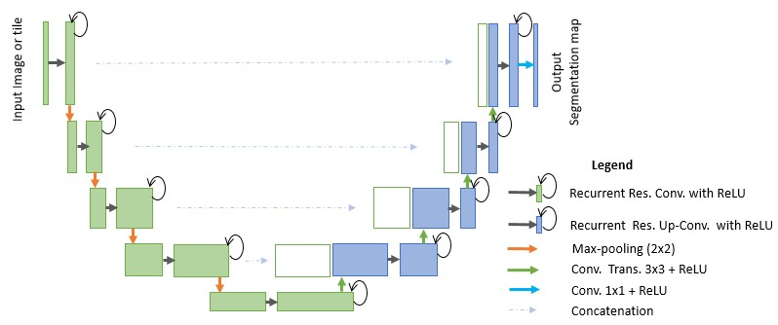
Future work
R2U-Net
Attention U-Net
Trans U-Net
3D U-Net
R2U-Net (Recurrent Residual U-Net), a U-Net variant, incorporates residual and recurrent techniques to enhance segmentation performance.
Notes:
For the future work, I want to briefly show more unet variants.
They are ...

Slide 20
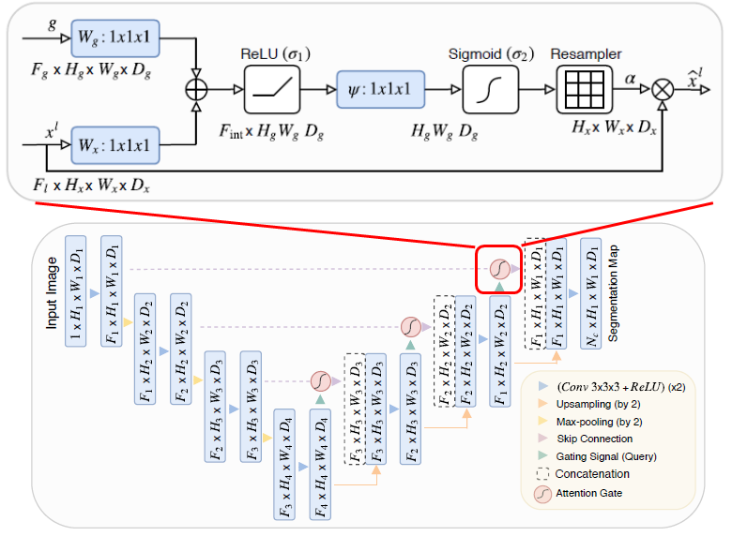
Future work
R2U-Net
Attention U-Net
Trans U-Net
3D U-Net
Attention U-Net enhances the original U-Net architecture by integrating attention gates in skip pathways, improving feature selection.

Slide 21
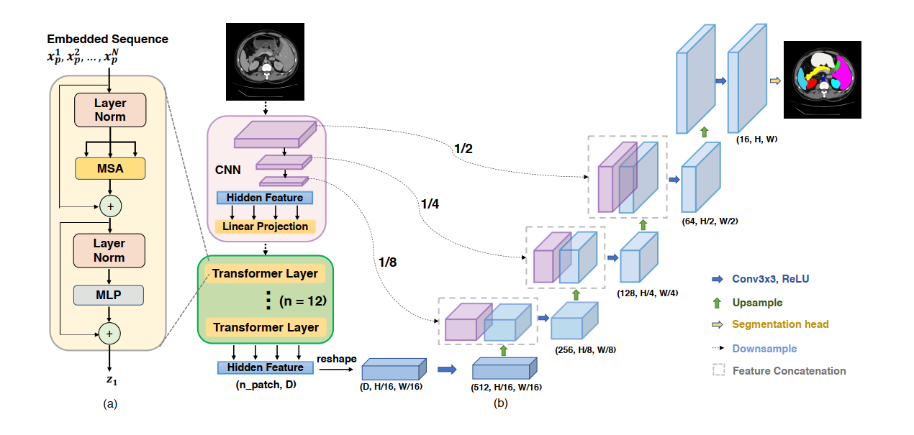
Future work
R2U-Net
Attention U-Net
Trans U-Net
3D U-Net
Trans U-Net leverages visual transformers (ViT) to create a powerful, transformer-based architecture for medical image segmentation.

Slide 22
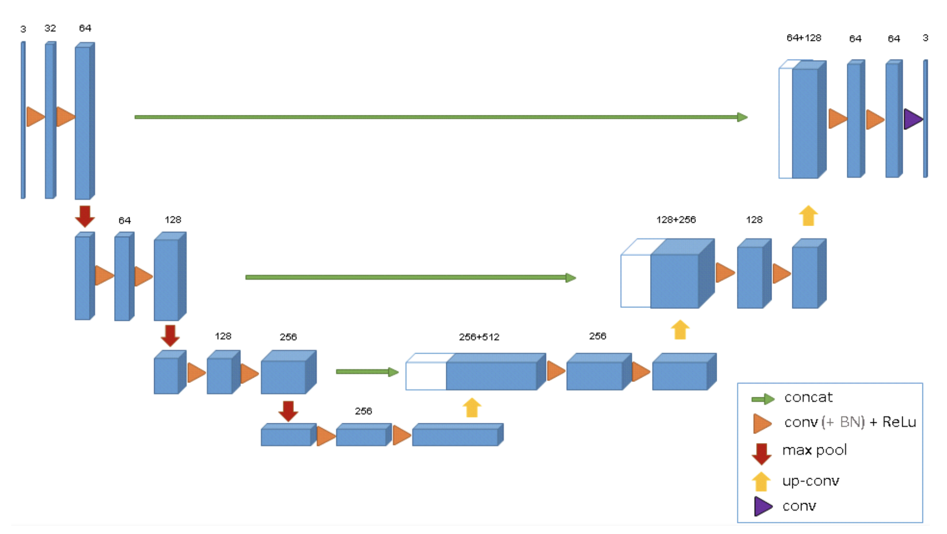
Future work
R2U-Net
Attention U-Net
Trans U-Net
3D U-Net
3D U-Net is a 3D extension of the original U-Net architecture designed for volumetric segmentation tasks.

Slide 23
Future work
Collaborate with clinicians and researchers to validate the model in real-world settings
Explore potential applications in early diagnosis, treatment planning, and monitoring of neurological diseases
Notes:
Also, we could work with researchers to validate the model in real-world early diagnosis.

Slide 24
Any Questions?

